Slide 1
Expert Determination v Arbitration
Paul Roberts - SVP ASIA PACIFIC SVP HKA Claims & Consulting Group

Slide 2
HKA
introduction
My name is Paul Roberts
I am Senior Vice President of Hill International Asia Pacific region. Hill was recently purchased by Bridgepoint Capital and are now HKA.
My presentation today will be on:
The distinction between Expert Determination and Arbitration in relation to tiered dispute resolution clauses.

Slide 3
Tiered Dispute Resolution Clauses
What are they?
A multi-tiered dispute resolution clause is a clause in a contract incorporating several different stages or alternative dispute resolution (ADR) methods for parties to resolve (or attempt to resolve) disputes.
Also known as “ADR first clauses”, “escalation” or “multi step”.

Slide 4
Tiered Dispute Resolution Clauses
What are they? (Cont.)
Examples include:
Negotiation;
Mediation;
Adjudication;
Expert determination.
Before providing for a binding resolution by litigation or arbitration.

Slide 5
Tiered Dispute Resolution Clauses
Why use them?
Opportunity to resolve disputes in less formal and adversarial settings.
Preservation of business/commercial relationship between parties.
Saving of time and money by resolving disputes without recourse to litigation or arbitration.
Tailored to suit the project and the types of disputes which may arise.

Slide 6
Expert Determination
What is it?
Expert Determination is often used as a mechanism for determining particular types of disputes, such as:
Valuation issues or other technical disputes, where the expert exercises his judgment by applying his expertise and industry knowledge to the facts presented.
Defined by Kendell as:
“Expert Determination is a means by which the parties to a contract jointly instruct a third party to decide an issue between them. The third party is now commonly known as an expert, and is a person who has usually been chosen for expertise in the issue between the parties”
The procedure is often streamlined and inquisitorial, with the expert adopting a suitable procedure depending on the nature of the dispute.
As a distinction from litigation and arbitration, Expert Determination is purely a creature of contract.

Slide 7
ARBITRATION
What is it?
Employed in England and Wales for centuries.
In its simplest form is a private form of final and binding dispute resolution by a third party.
Regulated and enforced by statute in Australia and around the world.
Internationally enforced through signatories to the New York convention 1958.

Slide 8
SIMILARITIES
Even though Arbitration and Expert Determination are different forms of dispute resolution, the two processes share a number of characteristics such as:
Private
Either method is selected by contractual agreement.
Parties can choose their decision maker or makers.
Typically someone knowledgeable in the field of the dispute.
They may both be final and binding. (More on this later)

Slide 9
Benefits of Expert Determination over Arbitration

Slide 10
The Rise of Expert Determination
As the cost of litigation and arbitration has risen over the years so has the prevalence of Expert Determination.
Determination, within many cases around the world, clients drafting their own bespoke forms of Expert Determination – e.g. dispute boards and DRA.
As a consequence of the rise of Expert Determination, this useful ADR process is often stretched beyond its limitations.

Slide 11
Benefits
It allows for the appointment of an individual who is familiar with the relevant specialist or technical issues to resolve a dispute.
It is usually cheaper, quicker and less formal than arbitration or litigation.
It helps parties to maintain business relationships (it is confidential and generally less adversarial than litigation or arbitration.)
It can dispense with the need for the parties to instruct their own independent expert witnesses (and sometimes their own lawyers.)
An expert can adopt an inquisitorial, investigative approach.
There is, arguably, a greater chance of finality.

Slide 12
Issues With Expert Determination over Arbitration

Slide 13
Issues – Procedure
Procedure
In Australia and signatory countries there is a set procedure for arbitrations.
Whereas the procedure for Expert Determination is governed solely by the contractual clause and the appointed expert’s terms of reference.
In Expert Determination the expert is not required to act judicially in weighing evidence placed before him or her.
The expert may reach a decision based on his or her own knowledge or investigations.

Slide 14
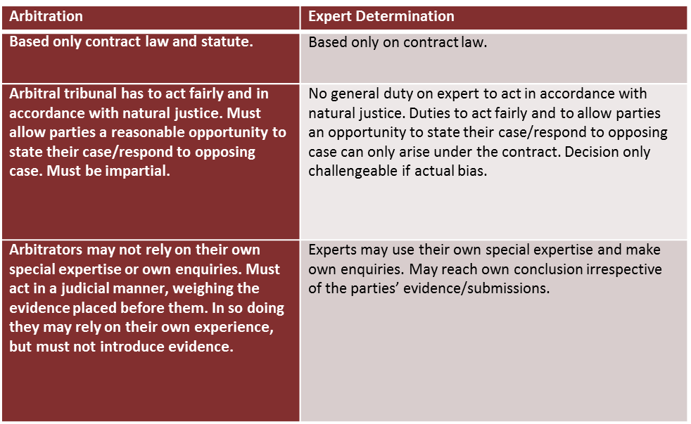
Issues – Procedure

Slide 15
Issues – Enforceability
Arbitration is enforced as if, or as, a court judgment.
A court will not go behind the decision making process of the arbitral tribunal, as long as the award is:
made in a manner that conforms with all relevant procedural requirements, and;
does not fall foul of the enforcing court’s public policy.
In International Arbitration the 1958 New York Convention provides a regime for enforcing awards in most countries.
Whereas a party attempting to enforce an expert’s decision in another jurisdiction may face significant hurdles.

Slide 16
Issues – Enforceability
Australia
In Australia the expert's determination is not enforceable in the same way as a judgment of a court or an arbitral award.
It does, however, create a binding contractual obligation and unless voluntarily complied with, court or arbitral proceedings are necessary to enforce the determinations.
Provided that the Expert Determination has been carried out in accordance with the contract, the court will not rehear the case and will be likely to deal with the application by means of a summary procedure.
This was confirmed recently in Australian Vintage Limited v Belvino Investments No 2 Pty Ltd [2015] NSWCA 275.

Slide 17
Issues – Enforceability
International
In international transactions, the outcome of the Expert Determination procedure is not clearly enforceable like an arbitral award.
To enforce an expert's decision will usually require separate proceedings for breach of the underlying agreement in a national court of a foreign jurisdiction.
In some jurisdictions, the law regarding Expert Determination is relatively untested, thereby adding additional time and costs of the proceedings.

Slide 18
Issues –Challenge of Decision
The decision of an expert is binding, and there are only limited grounds on which a party can challenge it.
In contrast, Arbitration provides mechanisms for setting aside the award of an arbitral tribunal on grounds of procedural irregularity.
In Barclays v Nylon, it was stressed that:
“the expert determines how he will proceed; it is rare for what might be perceived as procedural unfairness in an arbitration to give rise to a ground for challenge to the procedure adopted by an expert.”
Provided the parties have not agreed otherwise, arbitration allows a challenge to an arbitrator’s award on a question of law. This challenge is not available to the parties in expert determination.

Slide 19
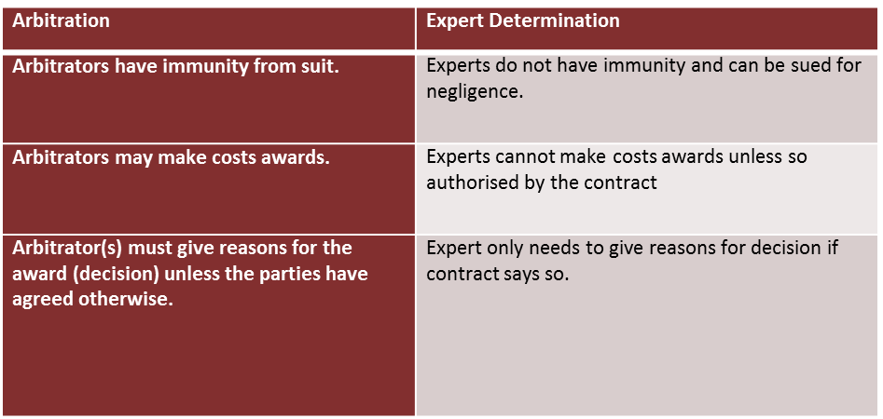
Other ISSUES/Differences

Slide 20
Drafting of Tiered Dispute Resolution Clauses

Slide 21
Pitfalls of Multi-Tiered Dispute resolution clauses
There are a number of pitfalls associated with the use of multi-tiered dispute resolution clauses.
It must be clear whether each step is optional or mandatory.
If the steps are mandatory, there may be consequences if one party decides to skip them and go straight to court or arbitration.
In the context of arbitration, failure to comply with a mandatory step can be used as an effective means of challenging the jurisdiction of the tribunal on the basis that compliance is a prerequisite to arbitration.

Slide 22
Expert Determination or Arbitration?
Distinguishing between expert determination and arbitration may sometimes be a rather difficult exercise when interpreting a Multi Tiered Dispute Resolution Clause.
Both are consensual mechanisms; both involve neutral decision-makers; and both produce, in principle, a binding decision.
Two recent cases from the UK highlight this:
Wilky Property v LSI [2011] EWHC 2226 (Ch) (Wilky Property v LSI)
Barclays Bank PLC v Nylon Capital LLP [2011] EWCA Civ 826) (“Barclays v Nylon”)
These cases highlight that in the event a clause is not clear one of the parties may form different views as to the process. The cases above found that the wording of the clauses was key to determining the intention of the parties.

Slide 23
Drafting - Best Practice
Expert Determination
Be clear on the scope of the expert and what type of dispute they are to be used for.
Ideally this would be drafted into the contract at the start to avoid any lengthy negotiations over the expert.
The above would facilitate an easier choice of expert(s), again a possible source of cost and delay to dispute resolution.
Be clear that the expert is not an arbitrator as this could cause the clause to be interpreted as arbitration.
Final and Binding?
Costs?

Slide 24
Conclusion
Growing trend in engineering, maritime and oil & gas industries to refer disputes to Expert Determination.
This is often done in lieu of using it for specific issue such as technical matters or valuations, and rather done on the basis of general disputes, with the intent of being final and binding.
If that is the case then the above issues show that Arbitration is likely to a better dispute resolution method.
Mindful of enforcement. Especially in International Context.
Best to draft clauses in such a way that allows flexibility whilst maintaining the original clear intention of the parties.

